Slide 1
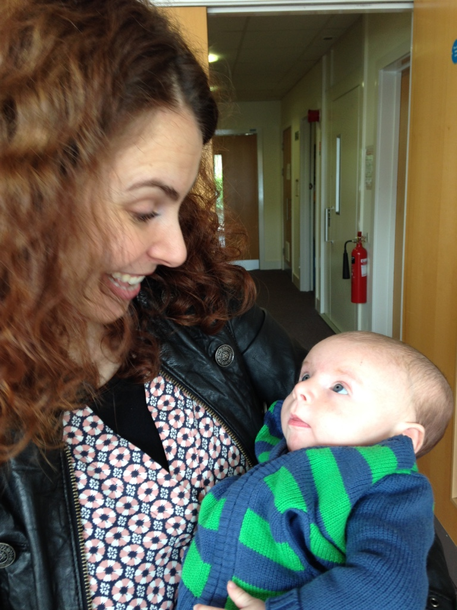
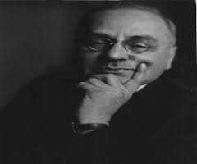
HOLDING THE BABY: Leadership that inspires - and contains ambition and anxiety towards Democratising early years leadership
Karen John, PhD
Developmental Psychologist,
Adlerian Psychotherapist & Supervisor
1

Slide 2
Overview of Talk
- PhD: Towards democratising early years leadership & practice
- Lack of confidence among early years leaders
- My abiding aim
- Adlerian ideas – some are explicit, others implicit
- Liz’s initial efforts to democratise Fairfield
- Encouraging: Holding, Containing
- Emotional intelligence & psychological resilience/courage
- Striving to overcome feelings of inferiority and insignificance
- Liz’s resilience, understanding & flexibility encouraged staff
- Christine’s aim of democratic & systemic practice at Gladstone
- Vital roles of schools, leaders, teachers, supervision & equality
2

Slide 3
History of NPQICL, MA & PhD in Leadership of Integrated Provision for Children & Families
Children’s Centres in England grew from 40 to 3,500 between 2002-2010, with initial funding to de-stigmatise and improve quality of local services by integrating nursery education, child care, social support - including health services, adult education & training, followed by surge of funding to reduce child poverty
National Professional Qualification in Integrated Centre Leadership (NPQICL) offered from 2004-2015, a part-time, year-long, work-based, experiential & academic program, conferring 1/3 MA credits
NPQICL values & competencies: reflective practice, practitioner-led action research, egalitarian & democratic principles, andragogy, life-long development & learning, mentoring & supervision
Part-time MA & PhD programs for leaders designed to increase confidence and effectiveness of EY professionals & settings

Slide 4
Analysis of Issues from NPQICL Pilot Mentoring Sessions with 23 Leaders
87% (20 of 23) were women (with men over-sampled)
61% felt like frauds or imposters as leaders
61% felt unsupported by their line managers, and confusion and lack of direction at Local Authority level
Initially, 100% admitted to lack of confidence, isolation or discomfort in their leadership roles
Worrying findings given need for confidence, clarity and resilience in inspiring and containing others…

Slide 5
My abiding aim is…
… to help individuals, families, staff teams, leaders, organisations and communities recognise and overcome the internal and external obstacles that interfere with their healthy, socially-responsible functioning
… towards democratising relationships

Slide 6
Adler’s explicit reasons for leaving Freud
In 1911 Adler left Freud’s Psychoanalytic circle & argued:
Striving for power or superiority is an effort to protect self esteem – the Oedipal Complex is but one example.
Individual Psychology conveys indivisibility of human feeling, thinking & behaving, as well as of physical & mental health.
Democracy has altered power relationships.
Even young children are highly sensitive to changes in power relationships.
Authoritarian / autocratic methods lead to defiance / disobedience / dysfunction.
New ways of relating are needed to optimise human potential.

Slide 7
Who is taking responsibility? Becoming an authoritative, democratic leader
Liz Klavins, Head Teacher Fairfield Nursery School & Children’s Centre, first led a team of 5 which rose to 50+ staff in just 4 years. She was inspired by democratic and child-led practice in New Zealand kindergartens. In her PhD case study, to improve practice, she sought to develop curious practitioners and embed practitioner-led action research at Fairfield, in a deprived area in the North.
She invited staff members studying for diplomas, BAs or MAs to be part of a Centre Inquiry Group, and they reached consensus re a shared project: looking into how staff might support children and their parents manage their separation better when starting nursery.
Liz was pleased with their progress - but disheartened when the project led to big ructions in the team.

Slide 8
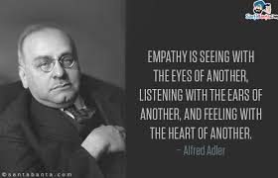
Encouraging us to understand ourselves and each other, Adler helpfully defined empathy:
(Adler, 1931, in Ansbacher & Ansbacher, 1956/1964, p. 14)
Our goal was walking the talk: pedagogical isomorphism...

Slide 9
Adler was not prescriptive regarding Individual Psychology’s method, but offered guidance…
There can be no rigid prescription for practicing IP, because the practitioner’s lifestyle will determine his/her approach.
The practitioner needs to: 1) establish a relationship with the client, 2) with the client identify the error in lifestyle, 3) encourage the client, and 4) help the client develop social interest.
Striving for significance needs to reside with the feeling of belonging and an interest in others.
The practitioner wins a client’s confidence and cooperation through ‘cheerfulness’, ‘steady friendliness’, belief in the client’s ability to solve their problems - and confidence in being able to help them without behaving like an authority.
(Orgler, 1939/1973; Ansbacher & Ansbacher, 1956/1964)

Slide 10
Implicit in Adler – and explicit central in Object Relations Theories, especially Winnicott & Bion
Holding (Pediatrician Donald Winnicott, 1958,1960) is:
Child’s sense of being held, literally in caregivers arms and figuratively in a safe environment.
Holding makes possible emotional development.
The child develops trust, identifies thoughts and feelings and develops the capacity to think, symbolise and play.
Containment (Psychiatrist Wilfred Bion, 1961,1962) is:
The infant’s projection of unmanageable feelings onto the primary care giver, who reflects them back such that they become more tolerable for the infant.
The continual process of the care giver hearing, absorbing and responding to cries of fear, anger, hunger and discomfort. Caregiver survives and infant is able to think!

Slide 11
When feelings are not heard or understood they tend to swamp our ability to think…
Thinking
Feeling

Slide 12
Containing others requires – and engenders – emotional intelligence & psychological resilience
emotional intelligence (EQ) - describes the capacity to perceive, assess and manage one's own emotions and to perceive and take account of the emotions of others – an aspect of social interest
psychological resilience – is the positive capacity to cope with stress and adversity, manage change and to regain courage and a sense of wellbeing following rejection, disappointment, failure or loss.
3

Slide 13
When it comes to getting along with others, cooperating, learning and achieving it is helpful to consider that…
Feelings count as much as - and often more than - knowledge or intellectual ability.
Strong feelings can overwhelm reason and performance.
We have gone too far in stressing the rational and regarding emotional intelligence and resilience as traits.
Resilience, like courage, arises from encouraging relationships, stable environments and processes that promote self-awareness, social equality, wellbeing - and help protect us from risk factors.

Slide 14
SUPERWOMAN
Striving to Overcome Feeling Inferiority
Superiority - Competition
Success
How am I doing?
Power
Position
Possession
S
E
L
F
P
R
E
O
C
C
U
P
A
T
I
O
N
I’m little
Inferiority
Failure
Complaining
Blaming
Fears
Excuses

Slide 15
SUPERWOMAN
Finding the Courage to be Imperfect
Superiority - Competition
How am I doing?
Success
Power
Position
Possession
Cooperative competition
S
E
L
F
P
R
E
O
C
C
U
P
A
T
I
O
N
Working together to make things better for everyone
SOCIAL INTEREST
Community Feeling
What am I doing?
Sharing
Enjoying
Creating
I’m little
Inferiority
Failure
Complaining
Blaming
Fears
Excuses

Slide 16
Who is taking responsibility? Becoming an authoritative, democratic leader
Liz demonstrated her resilience, persistence and courage by seeking to understand the effects of her initial efforts. She read Dreikurs on social equality, engaged an external consultant to facilitate a half-day focus group involving all staff, assured anonymity. The report showed that a significant minority felt overlooked and hurt, not clever enough to research practice.
Liz felt hurt by the findings but worked towards inclusion and bolstering morale through staff supervision, more opportunities for collaborative inquiry. A year later, another half-day focus group showed a positive shift in staff members’ feelings. Six months later all staff members felt secure enough to team up with 1-3 others to research a practice issue, over a full year. They shared their results with their colleagues as part of an Practitioner-led Action Research Market Place.

Slide 17
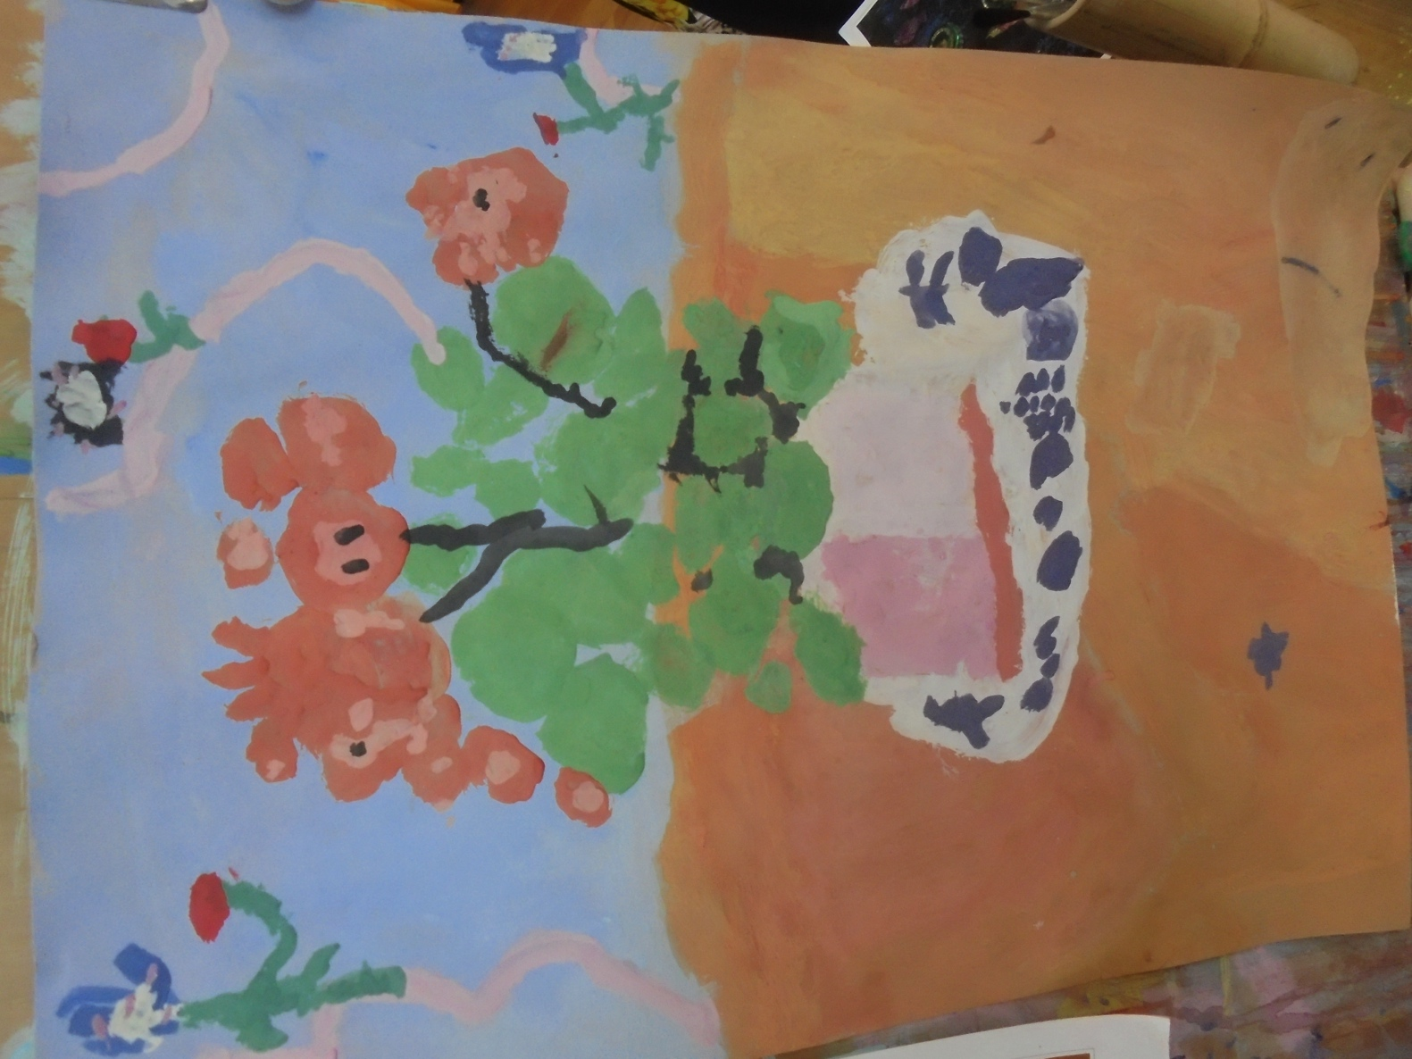
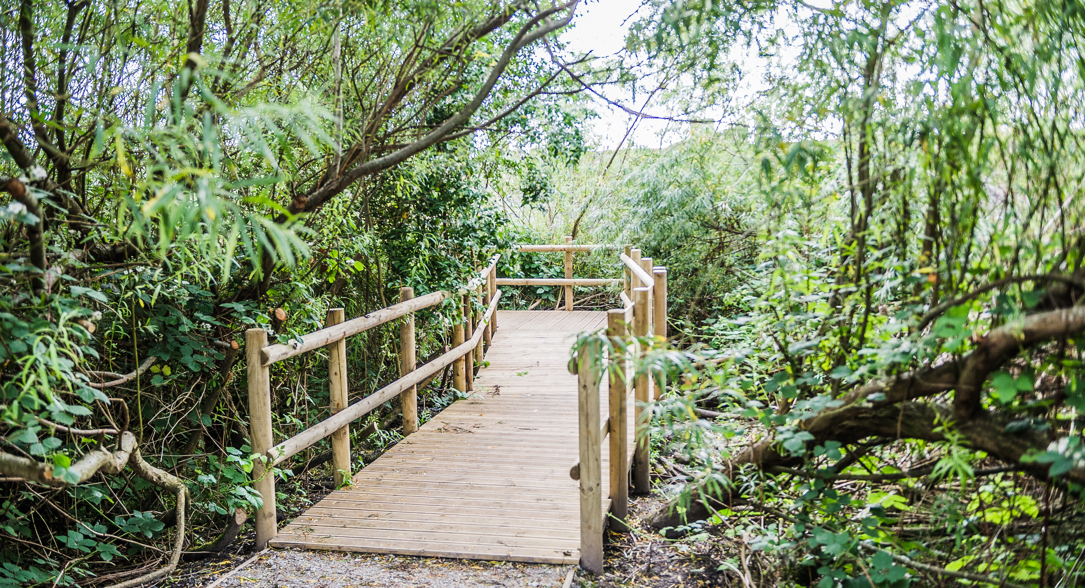
Who is taking responsibility? Becoming an authoritative, democratic leader
Liz sought to understand the needs behind staff members’ behaviour, slowed things down, and after 6.5 years of seeking to include and encourage them, documented in her lead-learner, action-research PhD case study, team members were creative and reliable in taking responsibility and improving practice.
Painted by a 4-year-old over 5 days Forest walkway conceived & created by staff

Slide 18
“We all have potential to lead because we all have responsibilities” Gladstone Primary School Student Council, 2010
Christine Parker Head Teacher, Gladstone Primary, a struggling school, with 100% multi-lingual and 90% Muslim 4-11 year-olds, in her PhD action research sought to encourage democratic, systemic thinking and practice throughout the school, including families and the community. Leaders, teachers, teaching assistants, lunch-time supervisors, parents and children were invited to keep reflective journals, be creative, contribute to reflective review and planning groups, take responsibility for and lead practice.
The Girls’ Chat Group grew from concern about underachievement among girls - and a racist incident initiated by three Muslim girls who targeted an Afro-Caribbean administrative worker. After being given time out of class to reflect and write letters of apology, Christine met regularly with the girls over the year, supporting them in writing reflective journals and responding to questions such as ‘What is racism?’ ‘What is bullying?’

Slide 19
RESEARCH EVIDENCE: Schools’ & teachers’ attitudes affect the wellbeing of children, families and communities
Teachers rated children from poorer backgrounds more negatively, despite reliable evidence of their cognitive, physical and social competence (John, 1997).
Regardless of cognitive ability at age 2, the cognitive development of children from poorer households was found to decline significantly by age 10, compared with their better-off classmates (Feinstein et al. 2007).
Increasing mentalisation, empathy, or ‘emotional intelligence’ of schools and teachers led to significant improvements in pupils’ behaviour and achievement with curriculum changes (Fonagy, Twemlow & Sacco 2005).

Slide 20
Adlerian insight: The role of schools & teachers in promoting social equality…
“An educator’s most important task, one might say holy duty, is to see to it that no child is discouraged at school, and that a child who enters school already discouraged regains self-confidence through their school and teacher. This goes hand-in-hand with the vocation of the educator, for education is possible only with children who look hopefully and joyfully upon the future …They simply must be convinced that what they have not yet achieved can readily be attained by industry, perseverance, practice, and courage. One must put tasks in their way, which they can accomplish, and from the accomplishment of which they can gain faith in themselves.”
(Alfred Adler, 1930, The Education of Children,)

Slide 21
How teachers and schools can be effective and make a difference…
Help children to become self-directed learners (Deci & Ryan, 1985)
Recognise that mistakes are part of learning and encourage effort (Dweck, 1999, 2006)
Promote cooperation & learning with peers (Brown, 1994; Rogoff, 1990)
Encourage children’s innate creativity (Robinson, 2007)
Acknowledge parents as their children’s first educators – and include and work with them as partners (DCSF, 2008)

Slide 22
How teachers and schools can be effective and make a difference…
are sensitive to children’s emotional needs
direct children’s activities in a rational, issue-oriented manner
encourage verbal give & take
discuss reasons behind policies & elicit children’s perspectives
exert control without over-restricting
(Baumarind, 1978, 1991; Chan & Choo, 2011)

Slide 23
How teachers and schools can be effective and make a difference…
develop & share their vision and values, including the need for social justice
work collaboratively with families, communities and other schools
acknowledge parents as children’s first teachers
make time to increase their own, children’s and families’ understanding of the social and emotional aspects of living and learning

Slide 24
“We all have potential to lead because we all have responsibilities” Gladstone Primary School Student Council, 2010
One 10-year-old girl’s reflective journal provides a moving account of her growing awareness of past wrongs and hurts, finding empathy for herself and others, taking responsibility, and developing a systems consciousness and deep sense of restorative justice. The girl went on to lead a whole school assembly of over 400 children and staff in an effort to raise others’ awareness of racism and bullying and the need for social equality and social justice.

Slide 25
“We all have potential to lead because we all have responsibilities” Gladstone Primary School Student Council, 2010
“Today we are going to think about bullying and racism and why it should stop. Bullying and racism is a sign of disrespect to the people that surround you and the community you live in. Bullying can happen in many different ways for example if you are fat, if you are short, if you are tall and many other ways. BUT BULLYING CAN STOP. But of course with the help of adults and together we will all work together as a team. We would like people to be treated equally in our city.”
(10-year-old member of the Girls’ Chat Group, 2013)

Slide 26
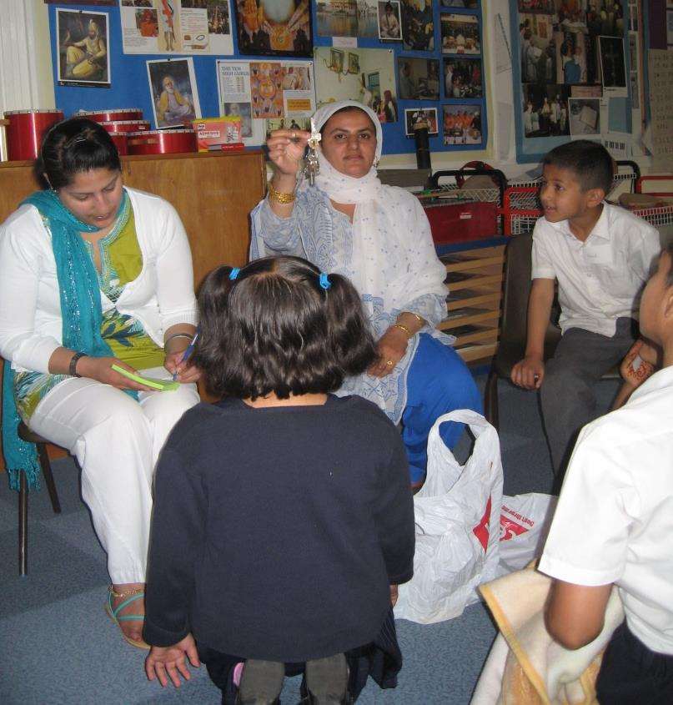
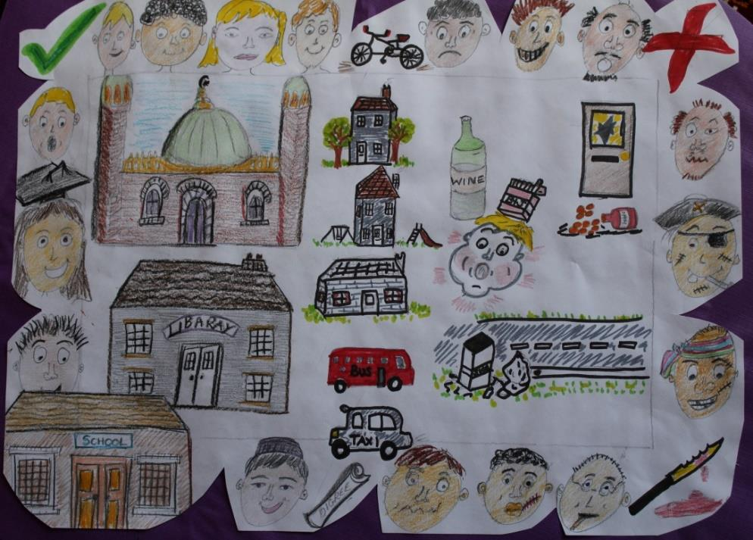
“We all have potential to lead because we all have responsibilities” Gladstone Primary School Student Council, 2010
A mother talked of her attachment to her old front door key and created a graphic representation of the locality. Her deep affection for the area and its diversity was undiminished by the realities of drug abuse, physical attacks and burglaries.

Slide 27
Leadership that encourages, holds and contains is central to effective parenting, teaching and management - and promotes emotional intelligence, social equality and resilience.

Slide 28
Research support for Adlerian leadership theory
Years of research show -
Troubled and troubling young people’s parents tend to be ‘authoritarian’ or ‘permissive’, compared with well functioning young people who feel good about themselves and achieve, who have authoritative / democratic parents (Baumarind, 1967-1991; Chan & Choo, 2011; Ferguson, 2013).
Parenting and parenting support programs bring shifts to authoritative parenting, more positive parent-child relationships & child behavior (Anning, 2007; John, 2001).
Sensitive and authoritative leadership in schools led to improvements in behaviour & achievement (Fonagy et al, 2005).
Staff satisfaction, creativity and effectiveness were found to depend on authoritative/democratic leadership; yet autocratic management tends to predominate (Hamlin & Sawyer, 2007).

Slide 29
Again, Adler on social equality
“Adler recognised equality as a fundamental prerequisite for the logic of social living; without it there can be no stability or social harmony…”(Dreikurs, 1971)
“If he/[she] can abandon a dream of the world …which was born of his/]her] vanity and which justifies his/[her] vanity, then more and more will it be possible for him/[her] to begin to feel him/[her]self an equal among equals, and less and less will he/[she] feel dependent on the opinions of others” (Adler, 1913).
“As soon as he/[she] can connect him/[her]self with his fellow [humans] on an equal and cooperative footing, he/[she] is cured” (Adler, 1931).
29

Slide 30
Sustaining effective human services requires that leaders and staff take part in regular supportive supervision with someone …
…they respect and trust, in order to share their feelings, dilemmas, doubts and fears, confidentially, without fear of recrimination
…who understands their circumstances and issues and can offer a wider perspective
…who provides a safe reflective and containing space
…who gives them the support and encouragement they need – so they can support and encourage others

Slide 31
Ideally, the line manager takes the role of supportive supervisor and creates a holding environment for staff members. Supervision then is contained within the wider organisational holding environment, or containment structure, so that staff are able to contain others.

Slide 32
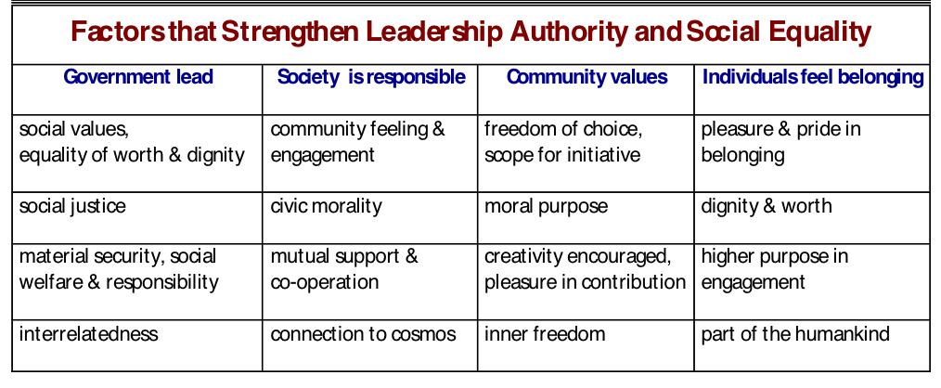

Slide 33
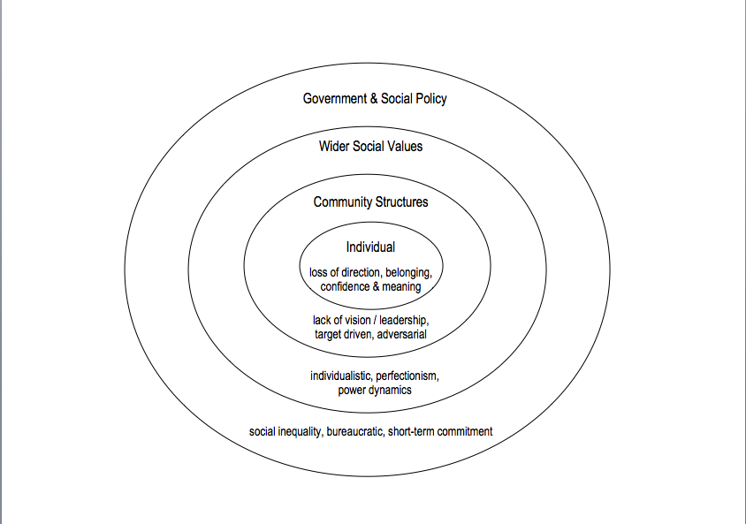
Case Study: When Good Authority is Compromised

